Slide 1
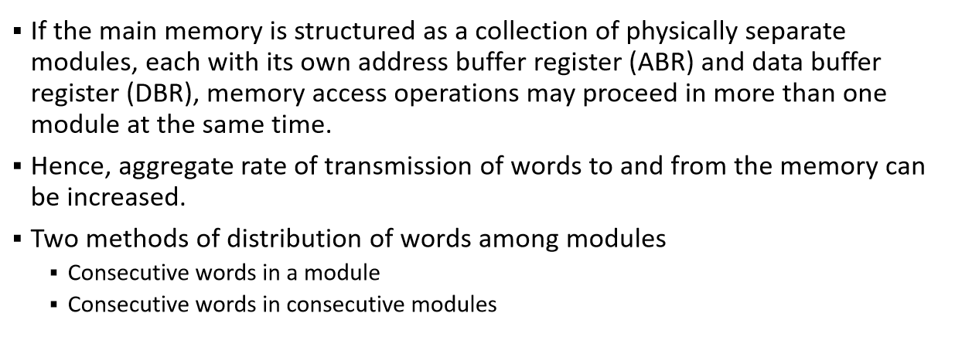
Memory Interleaving

Slide 2
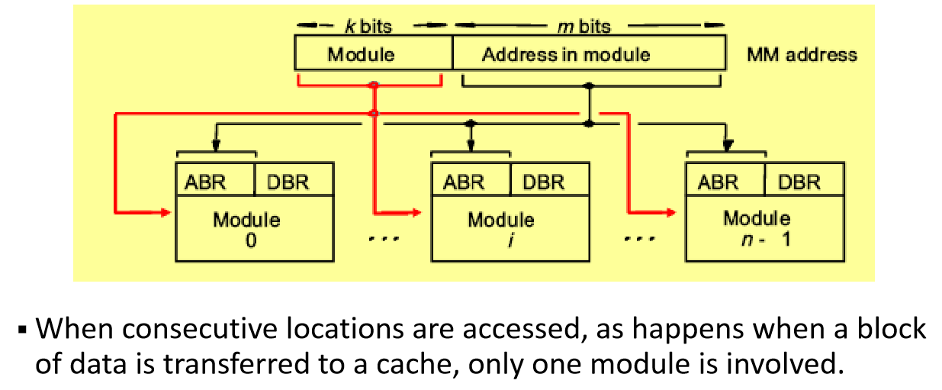
Consecutive words in a module

Slide 3
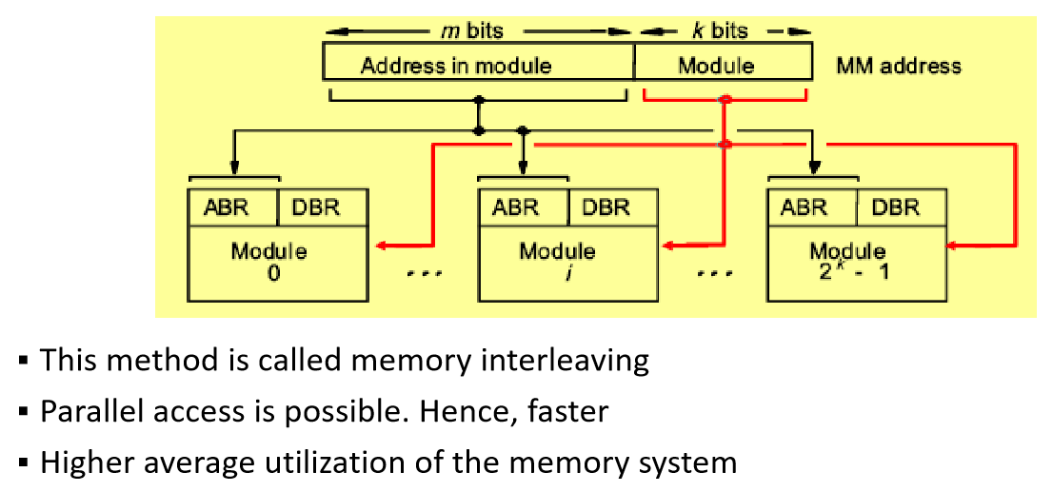
Consecutive words in consecutive modules

